Slide 1
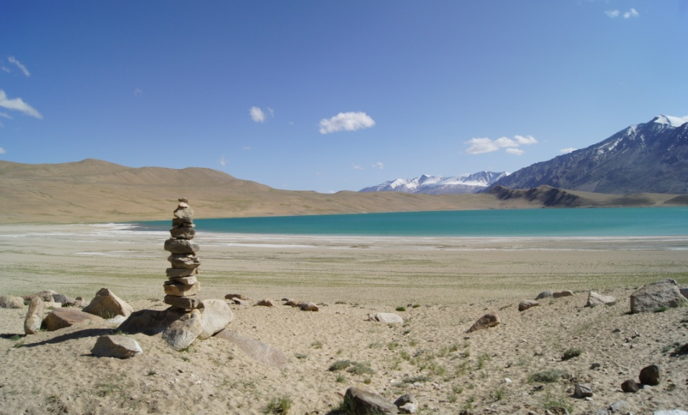
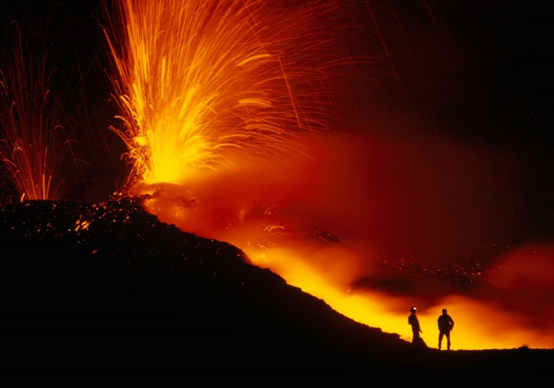
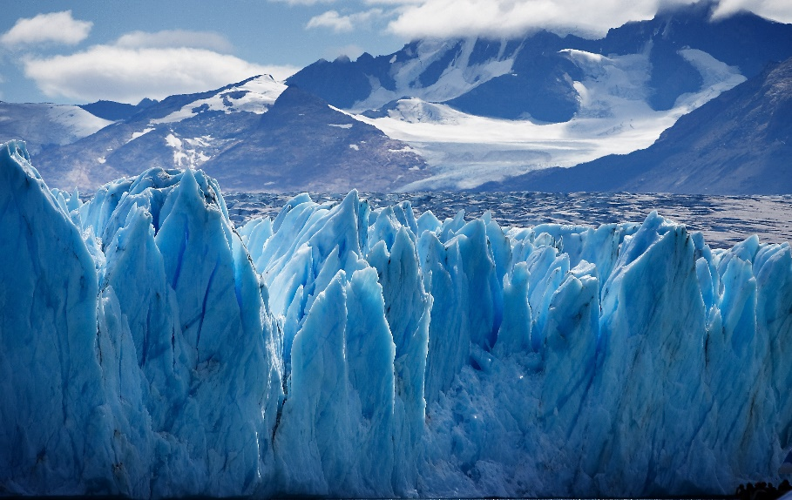
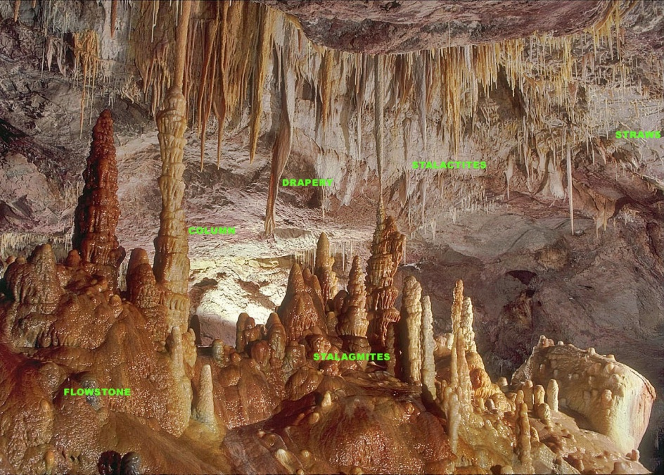
IDC203: IDC:203: Introduction to Earth Sciences

Slide 2
Deserts and wind action

Slide 3
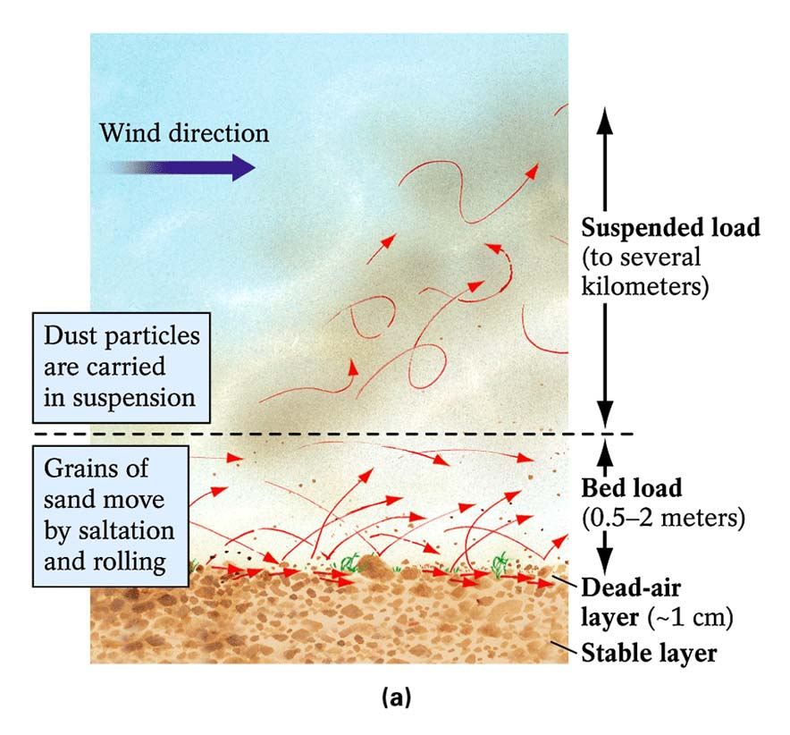
Wind-Borne Sediment causes deflation and abrasion
Sahara to Caribbean
Effect on Hurricanes
Surface creep

Slide 4
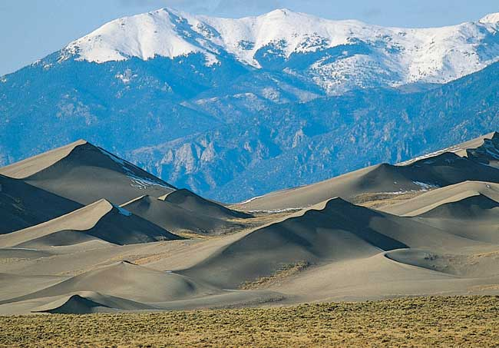
Deposition Landforms of Eolian Sands
Reduced wind velocity results in sediments deposition
Dunes are hills of loose wind-born sand
Size, shape, and orientation of dunes are determined by available sand, vegetation, and wind

Slide 5
Formation of loess deposits
Pre-glacial weathering
Glacial Erosion
Production of unsorted sediments
Transport by streams or debris
Transport by glaciers
Further particle size reduction
Deposition of mixed sediment size
Removal of fine silt and clay by winds
Aeolian abrasion and particle size reduction
Medium to coarse silt transported
for short distances in suspension
Fine silt and clay transported
for long distances in suspension
LOESS deposits
Widely dispersed dust
After Wright, 2001

Slide 6
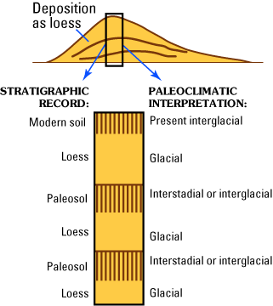
Paleoclimate implications of Aeolian Sediments
Diagram showing the nature of the loess stratigraphic record. In most regions, including much of North America, Europe, and China, loess was deposited during glacial periods and soils were formed during interglacial periods. Soils that become buried by younger loess are called "paleosols."

Slide 7
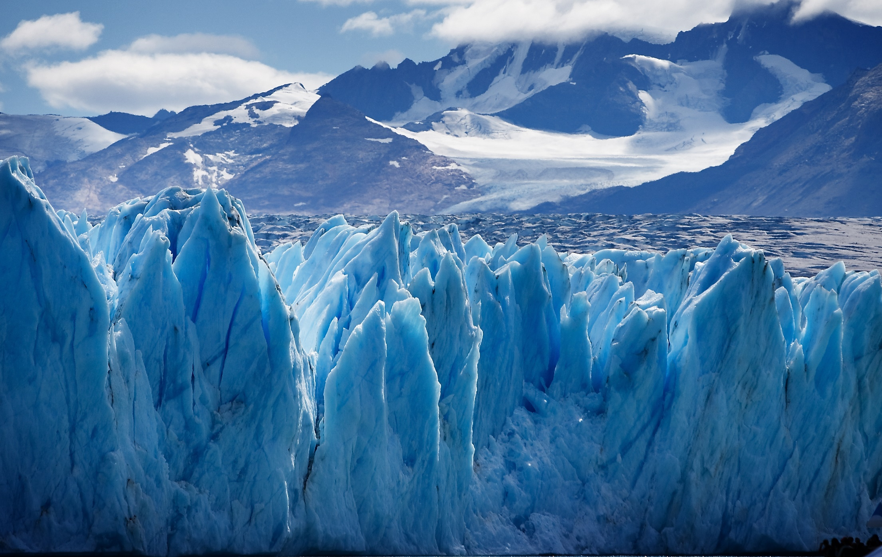

IDC:203: Introduction to Earth Sciences

Slide 8
Outline
Glacial: the work of ice

Slide 9
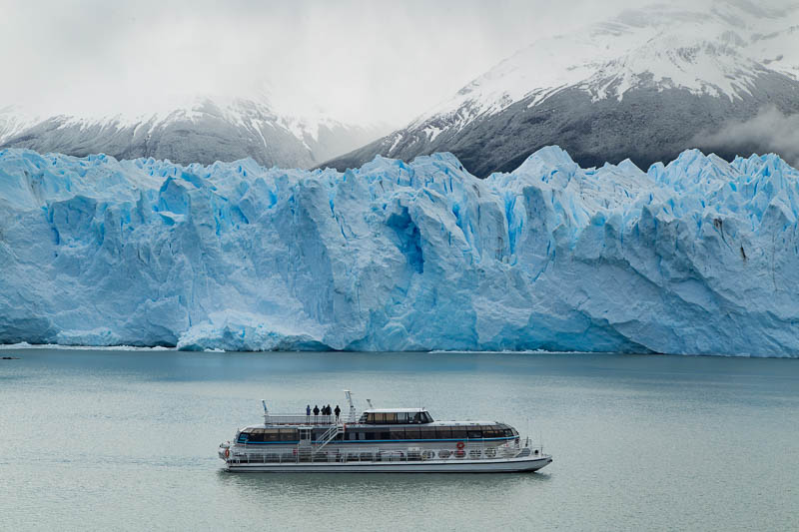
Glaciers: the Work of Ice

Slide 10
Glacier
Body of ice, snow, firn, and meltwater lying wholly or mostly on land showing evidence of present or former motion.
Glaciers form where more snow accumulates in winter than melts in summer.

Slide 11
Types of Glaciers
Based on their formation
Geophysical classification
Morphological classification

Slide 12
Types of Glaciers
Based on their formation
Alpine: restricted to mountainous systems
Himalaya, Alps
Continental: covers extremely large areas
Antarctica: 12,500,000 km2 up to 3 km thick, 80% of the ice on earth, 65% of the fresh water
Greenland: 1,700,000 km2 3.2 km thick

Slide 13
Types of Glaciers
Geophysical classification
Warm base - water at the bottom
Alps
Cold base - ice at the bottom
Antarctic and Greenland ice sheet

Slide 14
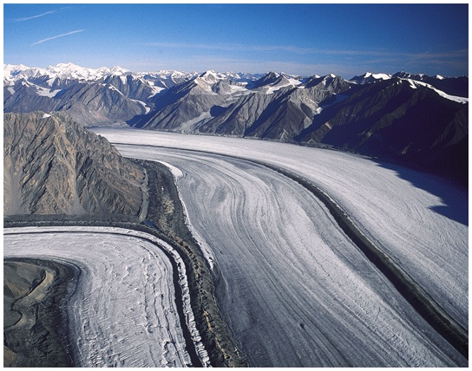
Types of Glaciers
Morphological classification
Valley glacier
Valley glaciers are streams of flowing ice that are confined within steep walled valley
Ice cap glacier
Ice shelf glacier

Slide 15
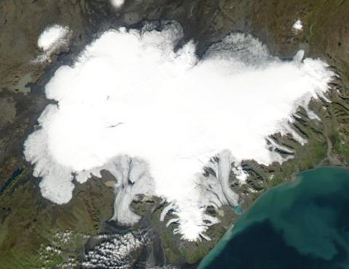
Types of Glaciers
Morphological classification
Valley glacier
Ice cap glacier
Ice caps are miniature ice sheets, covering less than 50,000 square kilometers (19,305 square miles) thin steep walled valley
Ice shelf glacier

Slide 16
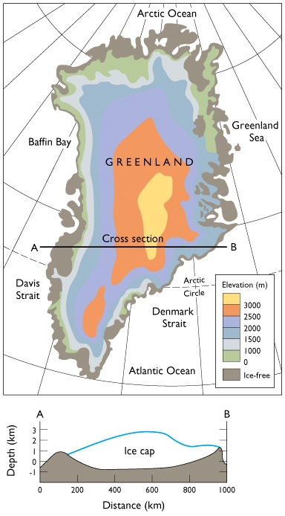
Greenland Ice Cap

Slide 17
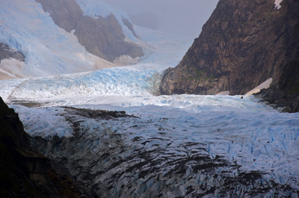
Types of Glaciers
Morphological classification
Valley glacier
Ice cap glacier
Ice shelf glacier
An ice sheet is a chunk of glacier ice that covers the land surrounding it and is greater than 50,000 kilometers (20,000 miles) wide.

Slide 18
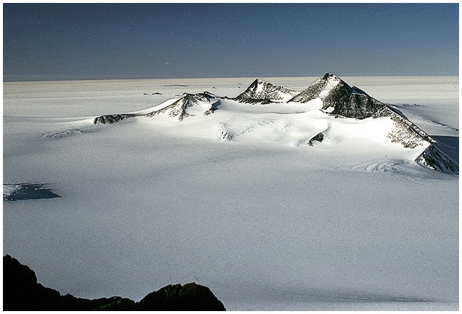
Sentinel Range, Antarctica

Slide 19
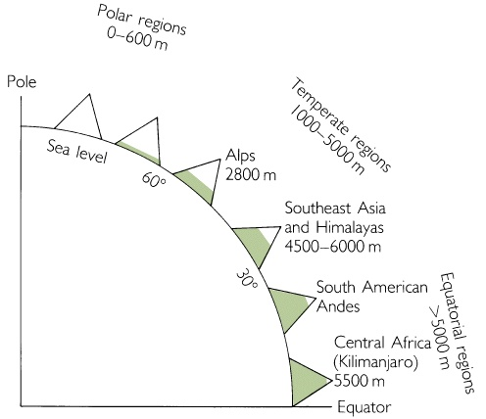
Variations in the Present Height of the Snow Line

Slide 20
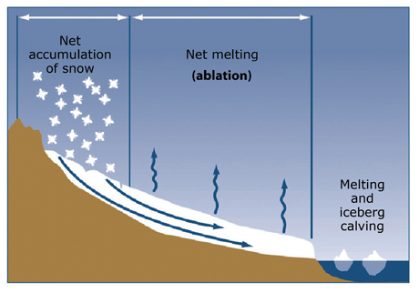
Glacial growth: Accumulation
Transformation of snow into ice
Snow may be thought of as sediment,
Firn as sedimentary rock, and
Glacier ice as metamorphic rock.

Slide 21
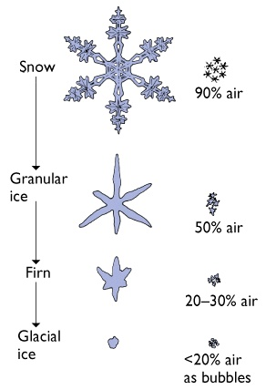
Transformation of Snow to Glacial Ice

Slide 22
Glacial shrinkage: Ablation
Melting
Iceberg calving: breaking off of chunks of ice at the edge of a glacier
Sublimation

Slide 23
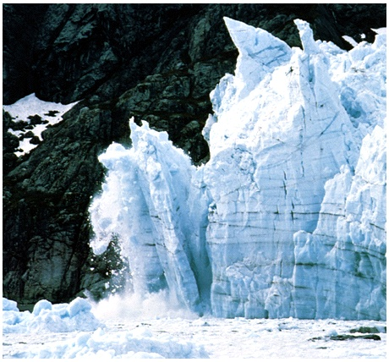
Calving Glacier, Glacier Bay, Alaska
Tom Bean

Slide 24
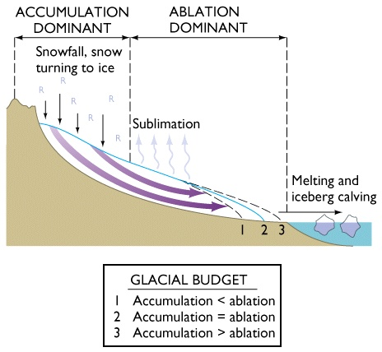
Glacial Budget

Slide 25

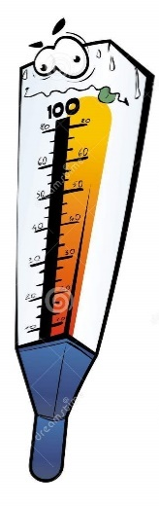
Mechanisms of motion in glaciers
Rates of glacial movement depends
Slope steepness
Precipitation
Air temperature
Water

Slide 26
Rates of motion
Extremely variable from one glacier to another
Millimeters to meters per day
Some glaciers move in surges: periods of rapid movement following periods of quiescence.
During surge, rates may be 50 m/day.
Rates vary with position in the glacier.

Slide 27
Glacial erosion
Water seeps into cracks, freezes and dislodge rocks which are then plucked out by glacier
Ice
Rocks are dragged along bedrock
Weathering processes
Temperature change
pressure release fracture
Bedrocks

Slide 28
Glacial erosion
Glacial erosional features
Plucking
rocks and stones become frozen to the base or sides of the glacier and are plucked from the ground or rock face as the glacier moves

Slide 29
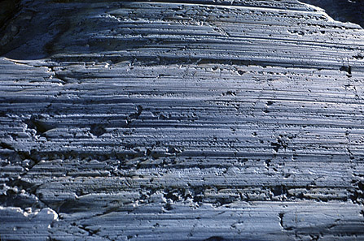
Glacial erosion
Glacial erosional features
Glacial striations
scratches or gouges cut into bedrock by glacial abrasion

Slide 30
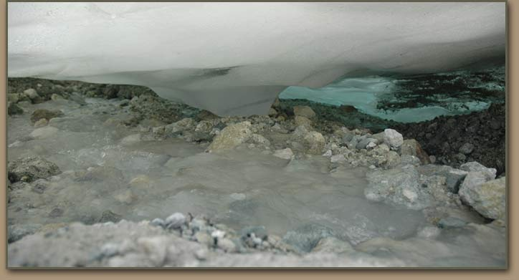
Glacial erosion
Rock flour
fine-grained, silt-sized particles of rock, generated by mechanical grinding of bedrock by glacial erosion
Rock flour

Slide 31
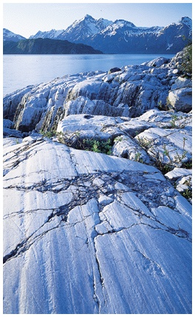
Abrasion
ice is soft, tools do the job
striations, polish, friction cracks
Quarrying (plucking)
V-shaped valley vs. U-shaped
hanging valleys
Glacier Bay National Park, Alaska
Carr Clifton

Slide 32
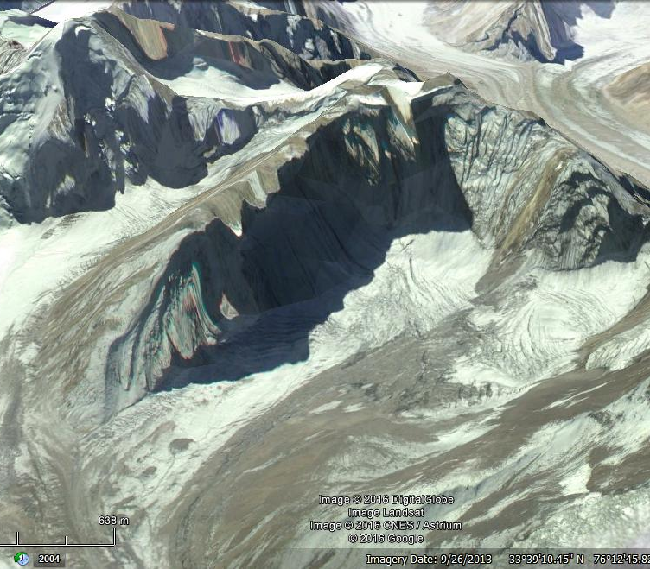
Glacial Landforms
1. Cirque
Amphitheatre shaped
Characterised by
Steep sided slope (3 sides)
Open end (one side)
Flat bottom
May also develop into tarn lakes

Slide 33
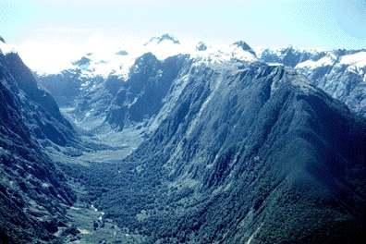
Glacial Landforms
2. “U” shaped valley
Uniform erosional activity
Horizontal and vertical
Steep sided and flat bottom

Slide 34
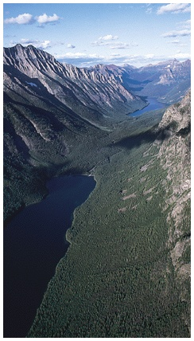
U-shaped Glacial Valley, Glacier National Park, Montana
Fig. 15.20
Steve Kaufman/DRK

Slide 35
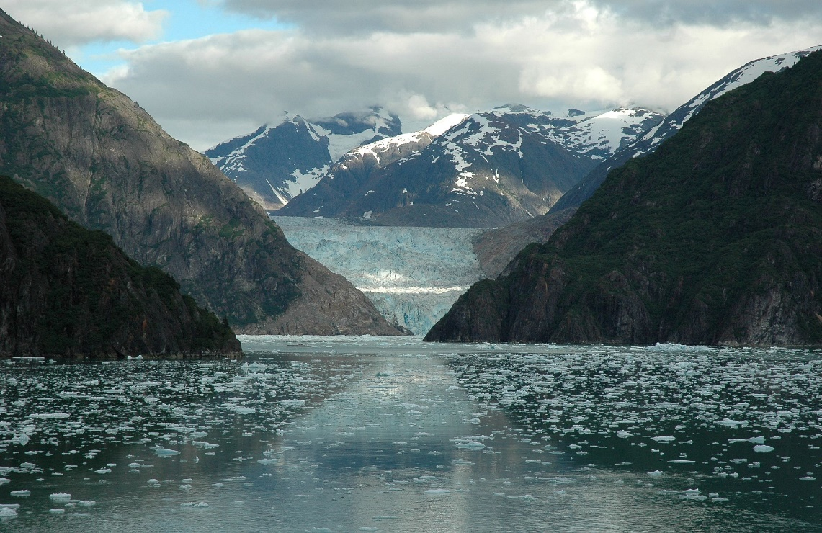
Glacial Landforms
5. Fjord
A fjord is formed when a glacier retreats, after carving its typical U-shaped valley, and the sea fills the resulting valley floor.
Narrow, steep sided inlet (sometimes deeper than 1300 metres) connected to the sea

Slide 36
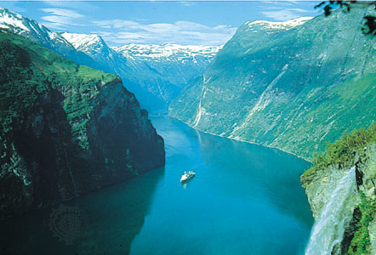
6. Fjord

Slide 37
Glacial Deposits
Erratics
Glacial drift
Till
Stratified drift

Slide 38
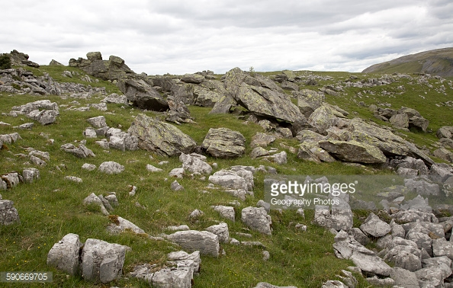
Glacial Deposits
Erratics
Large boulder size rock type
Transported by glaciers

Slide 39
Glacial Deposits
Glacial drift
Averages 6 m thick over the rocky hills
Two types
Till:
deposited directly by glacial ice
Highly variable
Variable grain sizes
Sharp edged or irregular shaped pebbles and cobbles
Stratified drift:
carried by streams and deposited by streams
Distinct horizontal bands
Rounded

Slide 40
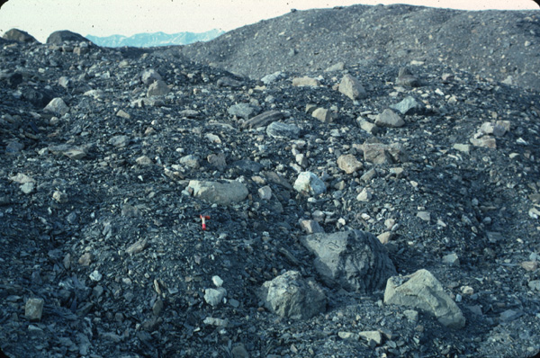
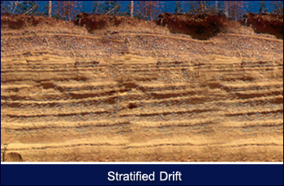
Glacial Deposits
Till
Stratified drift
Martin Miller

Slide 41
Landforms by Glacial Deposits
Moraine
Accumulation of till deposited
Based on the locations, characterised by several types.
- End moraine
- lateral moraine
-medial moraine

Slide 42
Lateral
Moraines
Stephen J. Krasemann/DRK Photo

Slide 43
Indicator Facies
Dropstones: Good indicator of glacial lacustrine/-marine environments where ice rafted debris was deposited as dropstones.

Slide 44
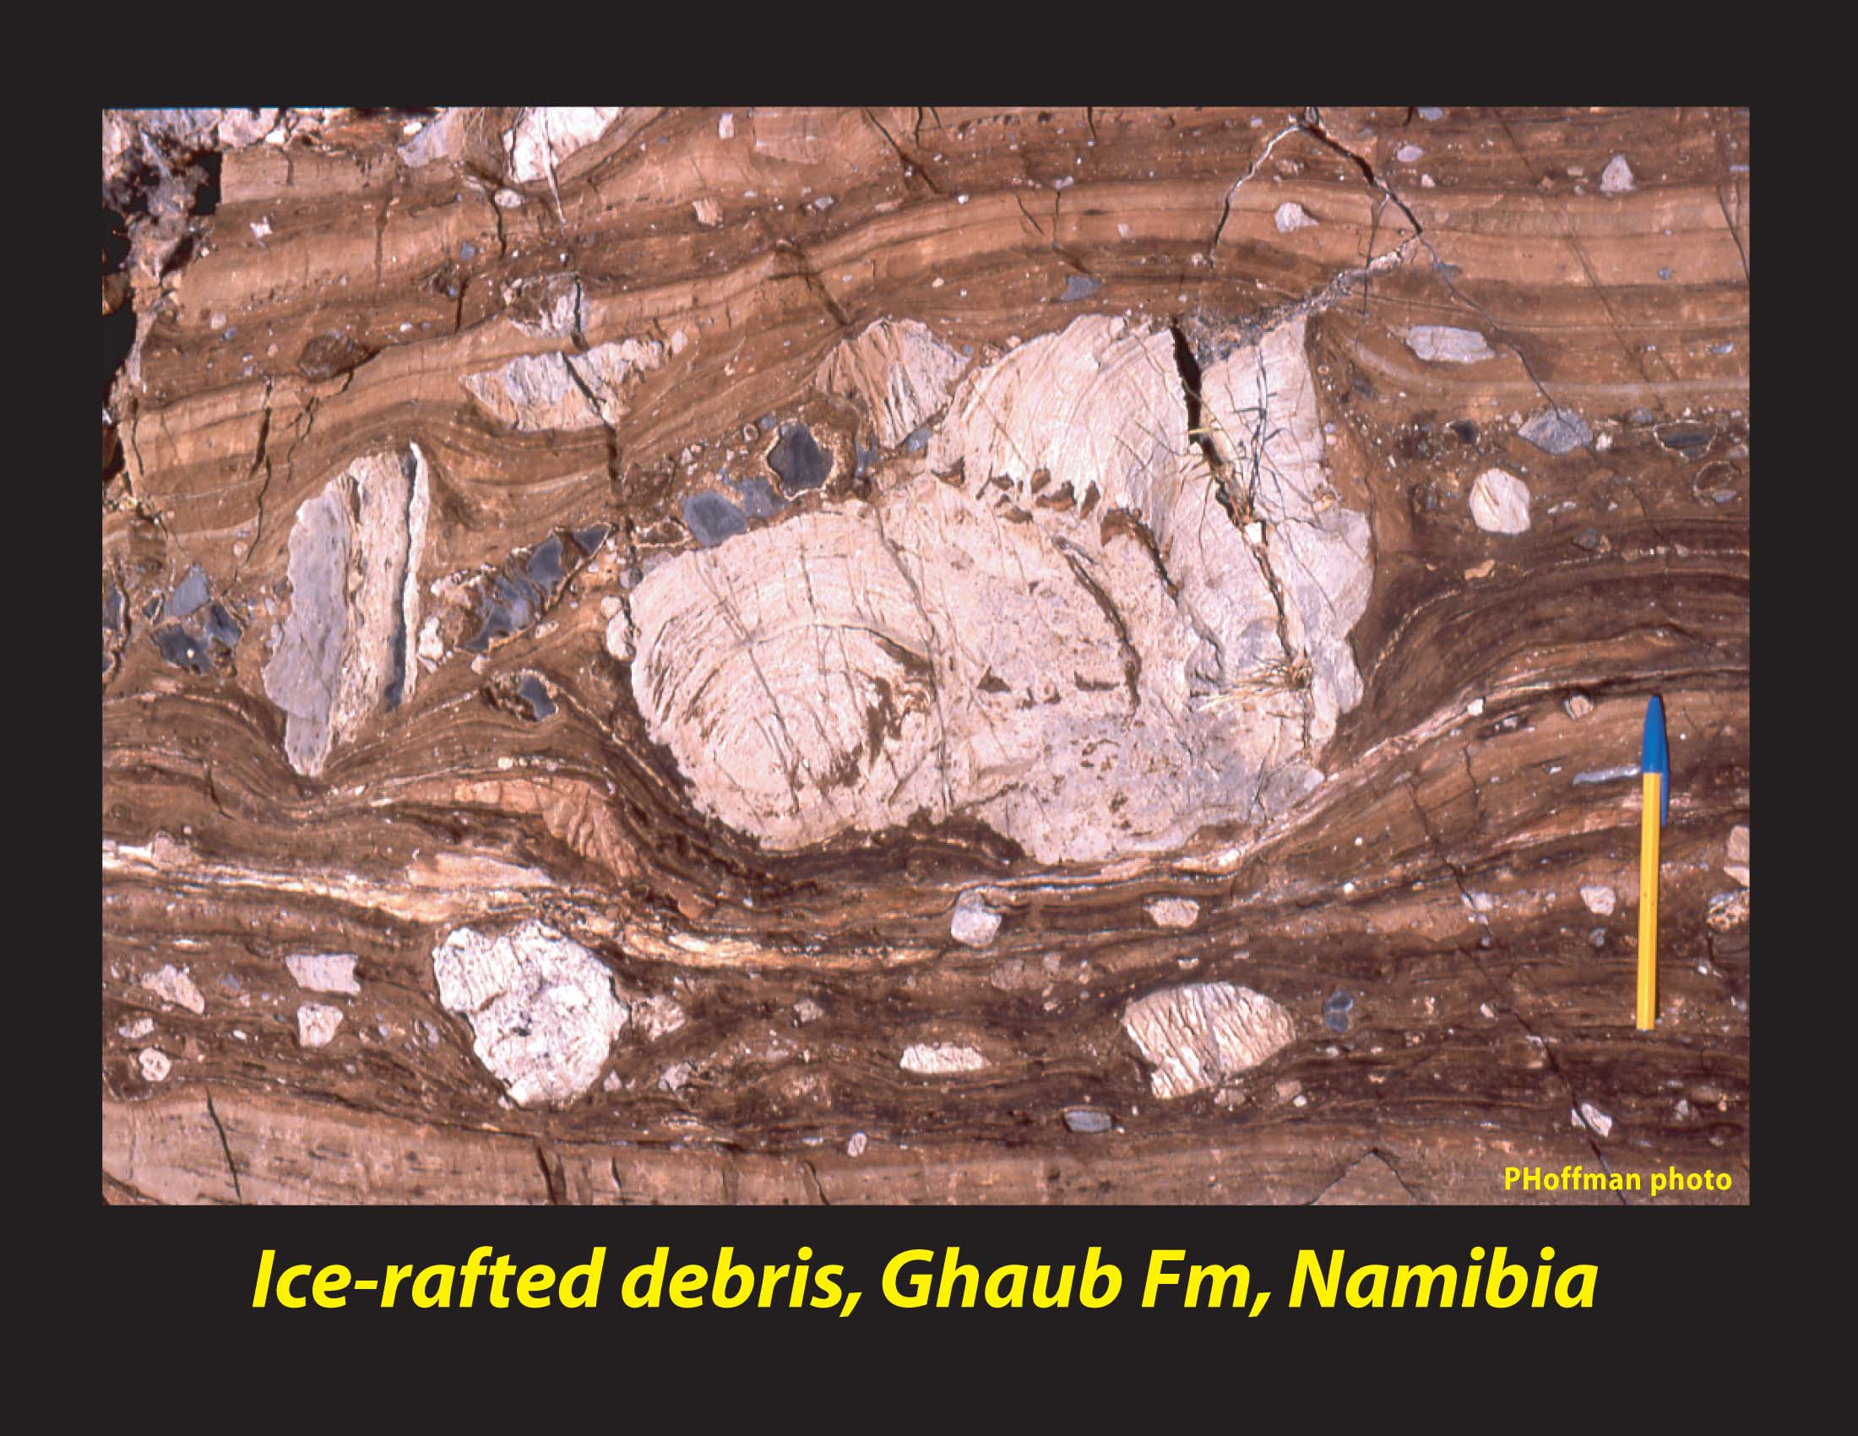
How we know it’s a dropstone:
“On-lap” of sediment at top contact
Deformation/penetration of laminated sediment at bottom contact.

Slide 45
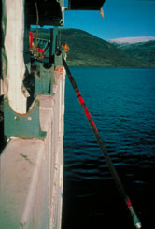
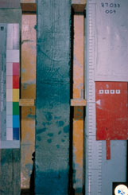
…. IN MARINE SEDIMENT ARCHIVES

Slide 46
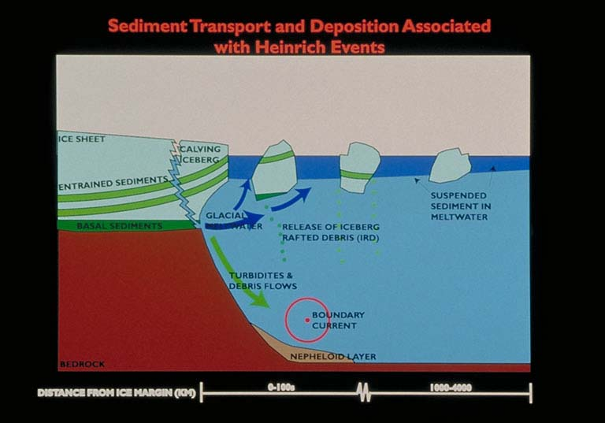
Transport of ice-rafted debris (IRD)

Slide 47
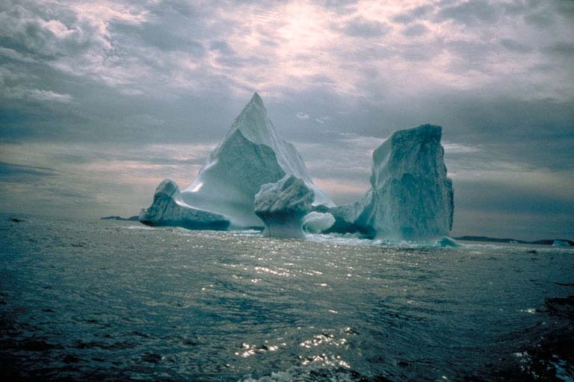
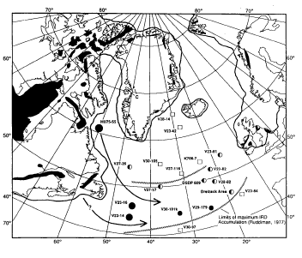
Site with ice-rafted debris
Site without ice-rafted debris
“IRD Belt” - based on
network of N. Atlantic
marine sediment records

Slide 48
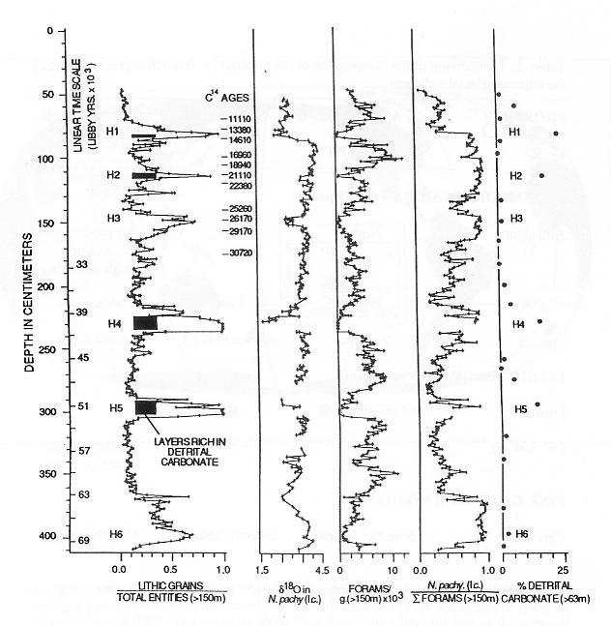
HEINRICH EVENT CHRONOLOGY
IRD peaks
Bond et al. (1992)

Slide 49
Ice Cores
Very important paleoclimatic archives.
Records of past atmospheric conditions.
Temperature
Snow accumulation
Atmospheric composition
Volcanic activity

Slide 50
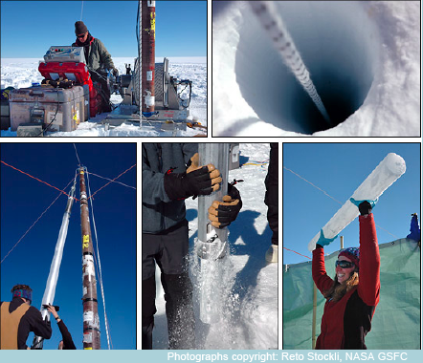
Ice Cores
Drilling into glacial ice allows us to see back in time.
Each winter new snow fall packs on top of previous snow. This creates a new band each year.

Slide 51
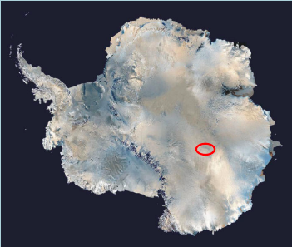
The Vostok Ice Core
The Vostok Ice Core is a Russian Station near the South Pole.
Their ice cores have produced climate data for the past 420,000 years!
Notes:
The ice cores can be taken from thousands of feet deep, but the length of the core depends on the length of the drill bit. Most drill bits are 4-6 meters long so scientists get extremely long ice cores (over 2000 meters) from increments of 4-6 meters.

Slide 52
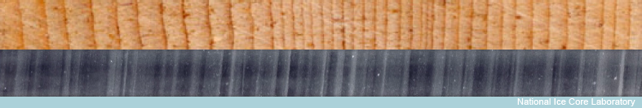
Dating Ice Cores
Ice cores are like tree rings
Summer ice appears light
Winter ice appears dark
How many years do you see?
Notes:
The summer bands appear white because the snow experiences 24 hours of sunlight in the polar regions. This changes the texture compared to the 0 hours of sunlight that it receives in the winter.

Slide 53
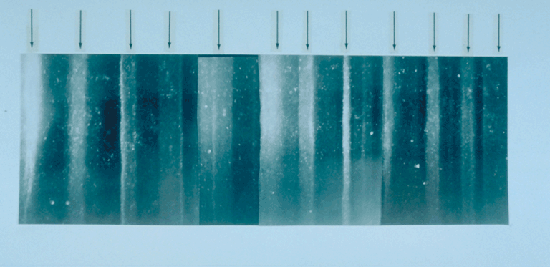
Dating Ice Cores
This ice core shows 12 years

Slide 54
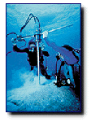
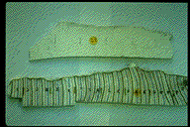
1. Coral Reefs
Corals are composed of calcium carbonate.
This carbonate contains isotopes of oxygen that can be used to determine the water temperature when and where the corals grew.

Slide 55
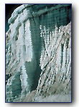
2. Ice Cores
As snow and ice accumulate in polar glaciers a paleoclimate record accumulates of the environmental conditions of the time of formation
.
Ice cores can analyzed using stable isotope approaches for water or air bubbles within the ice as a record of past atmospheric gas concentrations.

Slide 56
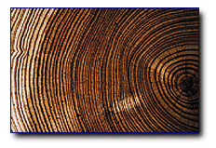
3. Tree Rings
Tree growth is influenced by climate. These patterns can be seen in tree ring width and isotopic composition.
Trees generally produce one ring each year.
Trees ring records can extend back to the last 1000 years.

Slide 57
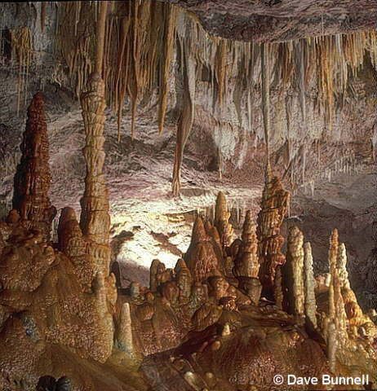
4.Stalagmites
Form from the bottom of the cave
They comprises of calcium carbonate

Slide 58
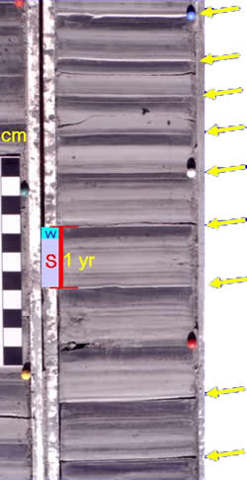
5. Sediment Cores
Sediment cores can be taken from lakes, the shallow ocean, or the deep ocean.
In some cases the thickness of these layers can be used to infer past climate.
In other cases, these layers are composed of organic material that can be analyzed for other climate proxies.

Slide 59

Pollen
Pollen grains are well preserved in lake and ocean sediment.
The analysis of each of these sediment layers provides information on the vegetation present at that time.
Scientists can infer past climates (warm or cold) based on the distribution and changes in plant species.

Slide 60
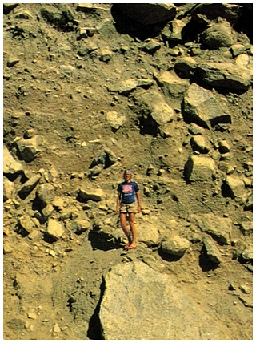
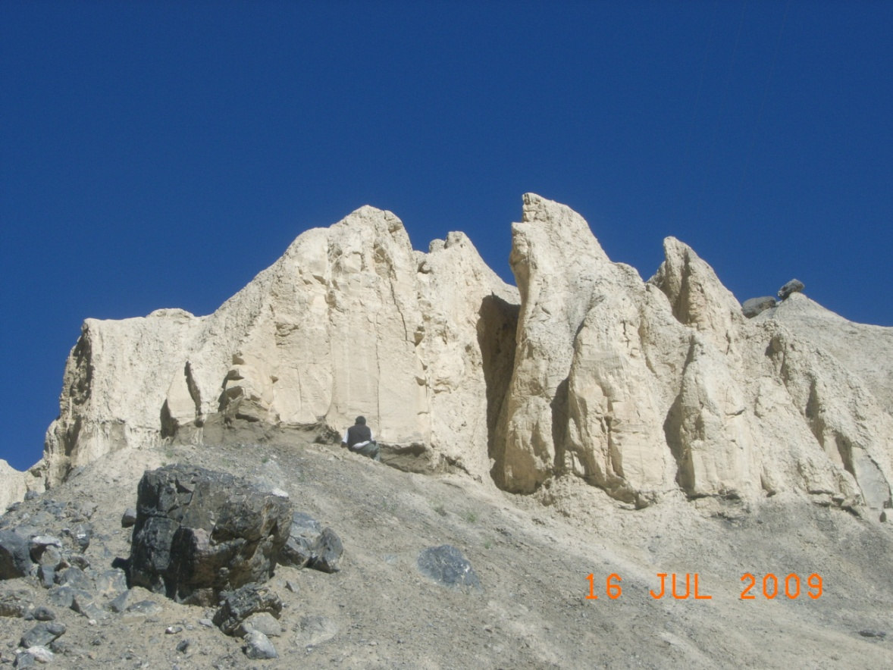
7. Moraines and fluvial systems

